Slide 1
Transit Phone Application
User Survey Analysis
Survey of 10 real-world users to understand the pain points and Opportunities
Product Improvement Case Study
Praneeth Koduru

Slide 2
Survey Objective
Content
Understand the user pain points with the current Transit Phone App.
Identify usability, feature, and performance gaps.
Gather insights to shape MVP feature set.
Survey Method
Google Forms(Survey Link)
5 questions
10 Responses
Targeted Frequent and Infrequent Users.

Slide 3
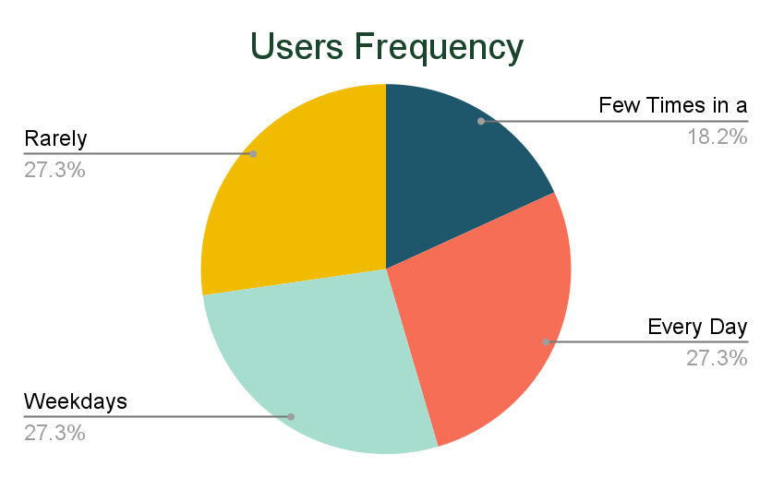
User Demographics
55% Users are Regular Commuters using the App.
45% Users are not Frequent Users and are Occasional Commuters.

Slide 4
Top Frustrations
Frustration Area | Customers Say
Live Tracking Issue | “No proper live routes”, “Live tracking not updated”
Nearest stop confusion | “I want to know what buses stop at my nearby stop”
UI/UX issues | “Can you make it more simple?”, “Random pin on map”
Scheduled Timing and Wait Time Issues | “Wait time doesn’t reflect properly”, “Saturday timing wrong”
Premium complaints | “Premium withholdings”

Slide 5
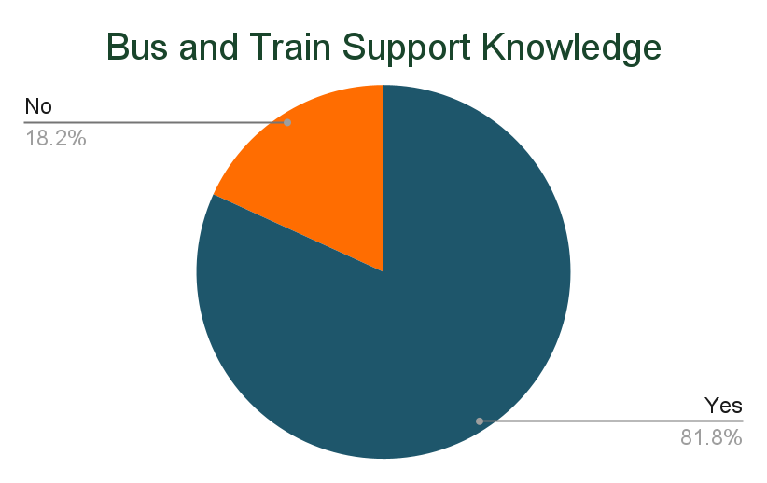
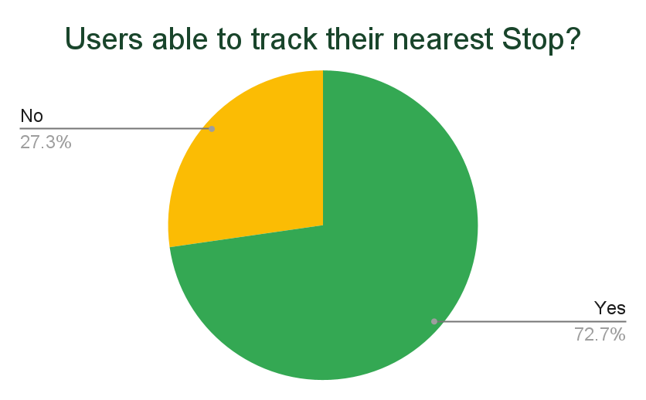
Transit Features Awareness
20% Users are not aware of Multi-Transport Support on the App.
30% Users are not able to locate their near Bus Stop/Train Station.

Slide 6
User Suggestions for Improvement
More accurate live bus tracking.
Clearer stop-specific arrival info.
Simplified user interface.
Improve reliability of wait time display.
Better support for student riders (e.g., subscriptions, alerts).
Proper Routing Information.
Increase Bus Frequency.

Slide 7
Key Insights
Live tracking is unreliable — top complaint (40%).
UI/UX issues cause confusion and frustration (30–40%).
Stop-specific data is unclear or inaccurate for 30% of users.
Feature visibility and communication need improvement.

Slide 8
MoSCoW Analysis
Features | Must Have | Should Have | Could Have | Won’t Have
Accurate real-time tracking | ✅
Dependable routing and wait-time info | ✅
Student support features |  | ✅
Advanced trip planning |  |  | ✅
Personalized suggestions |  |  | ✅
Simplified, intuitive UX/UI | ✅
Clearer multi-modal transport visibility |  | ✅
Increase in bus frequency |  |  |  | ✅

Slide 9
Deliverable Plan
A 3-Phased Delivery with 8 Sprints.
Target Metrics for the Case Studies:
+40% Real-Time Accuracy
–30% UI/UX Frustration
–35% Data Errors
+10% Feature Awareness
–25% Info Search Time
100% Agile Delivery

